Slide 1
Ggplot2 and interactive graphics with R
Christophe Ladroue
SECTION 03
VIDEO 05
Facetting on multiple variables
www.PacktPub.com

Slide 2
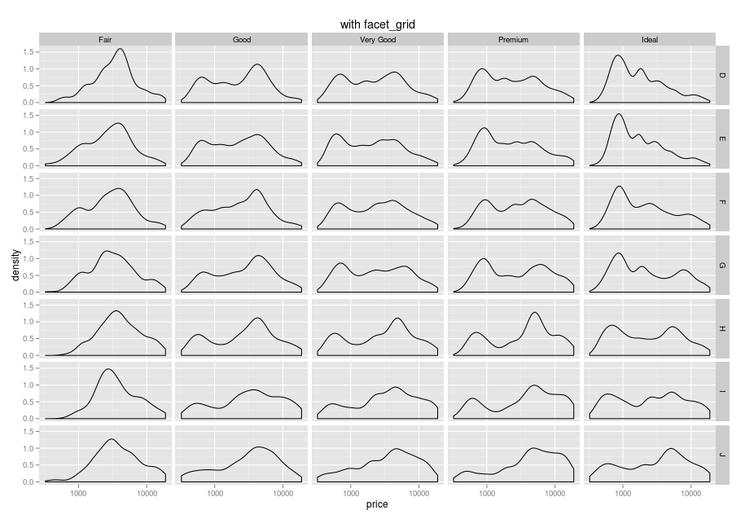
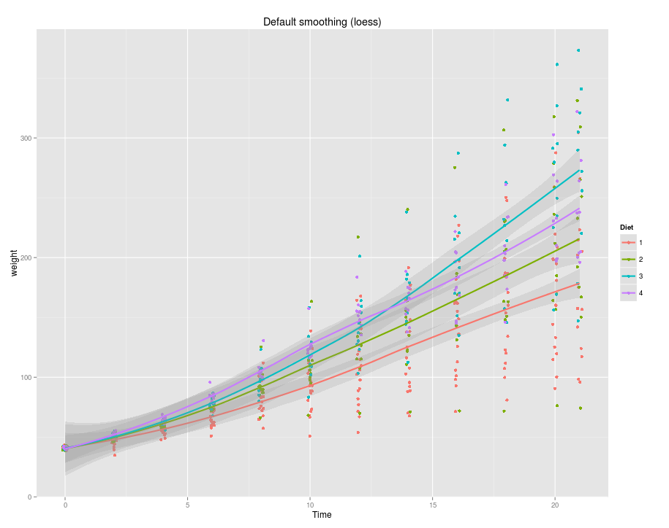
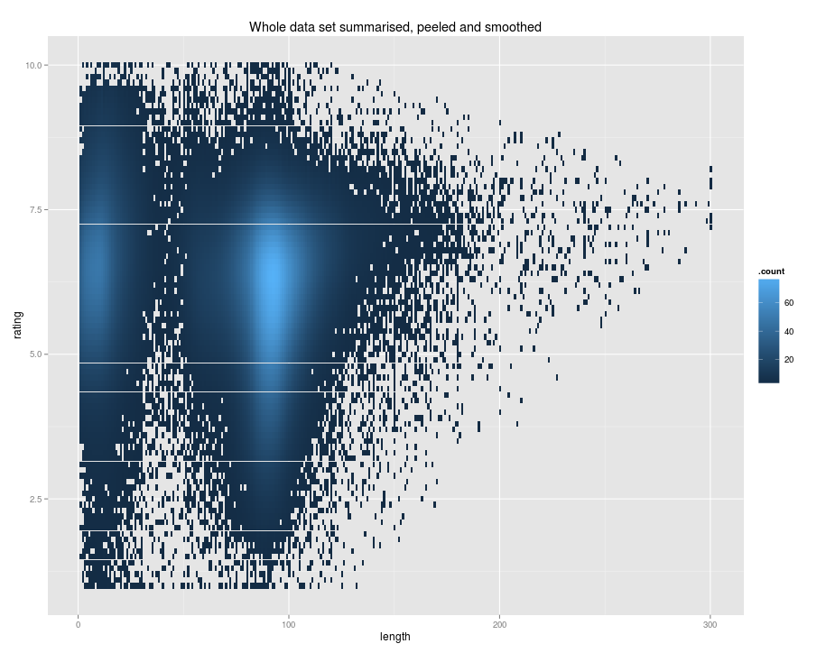
In this video we took a look at
how to produce individual plots given 2 variables.
how facet_wrap and facet_grid arrange the plots in a different order.
Next: trends and big data

